Slide 1
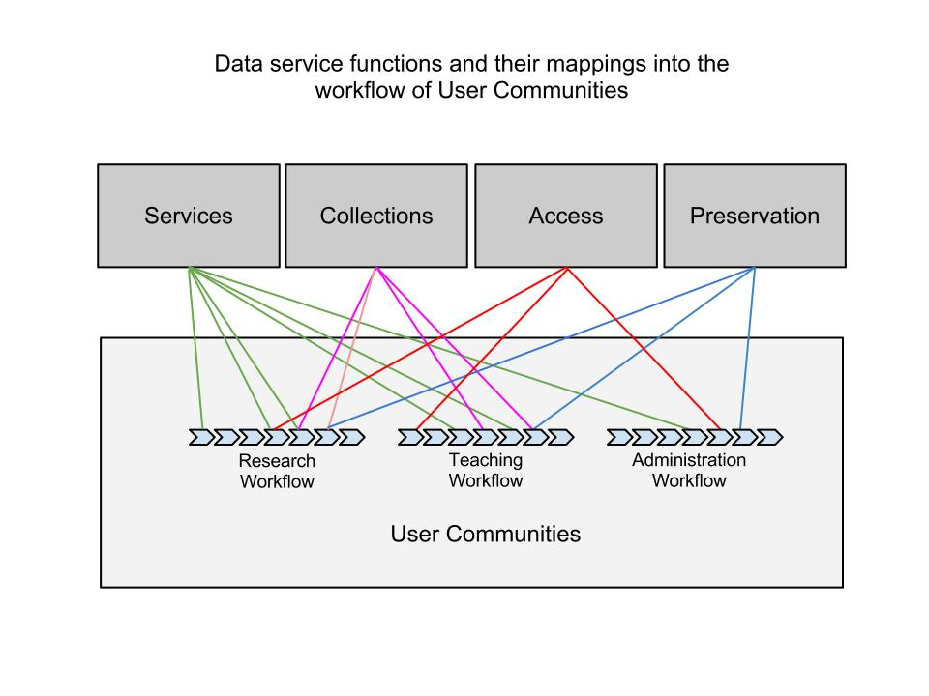
Mapping functions to lifecycles

Slide 2
Supporting Researchers with Confidential Data Requirements
Environment | Researcher Community | Collection | Services | Access | Preservation
UCSD | New Users |  | Referral
Purdue | Producers | Identify repository | Referral
U Alberta | Analysts | Negotiate with producer | Disclosure analysis | Secure analysis environment | Not responsible

